Slide 1
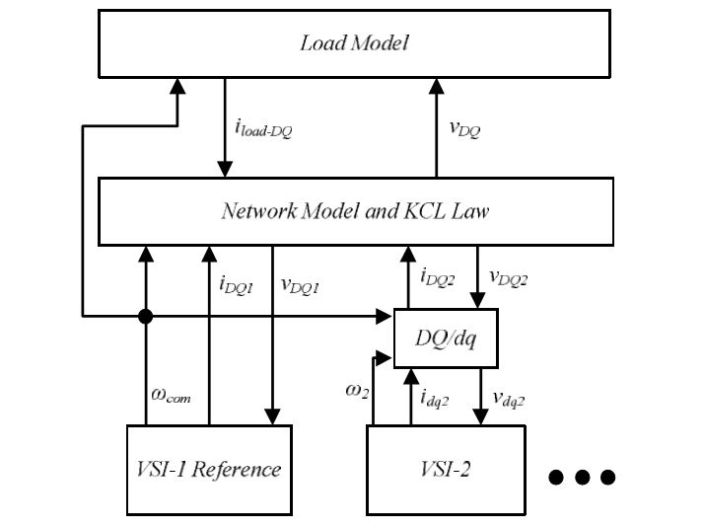
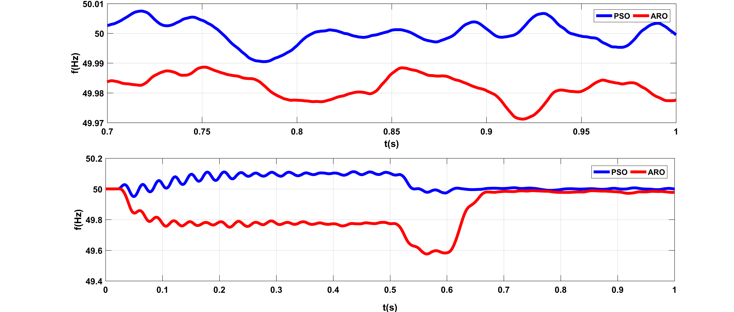
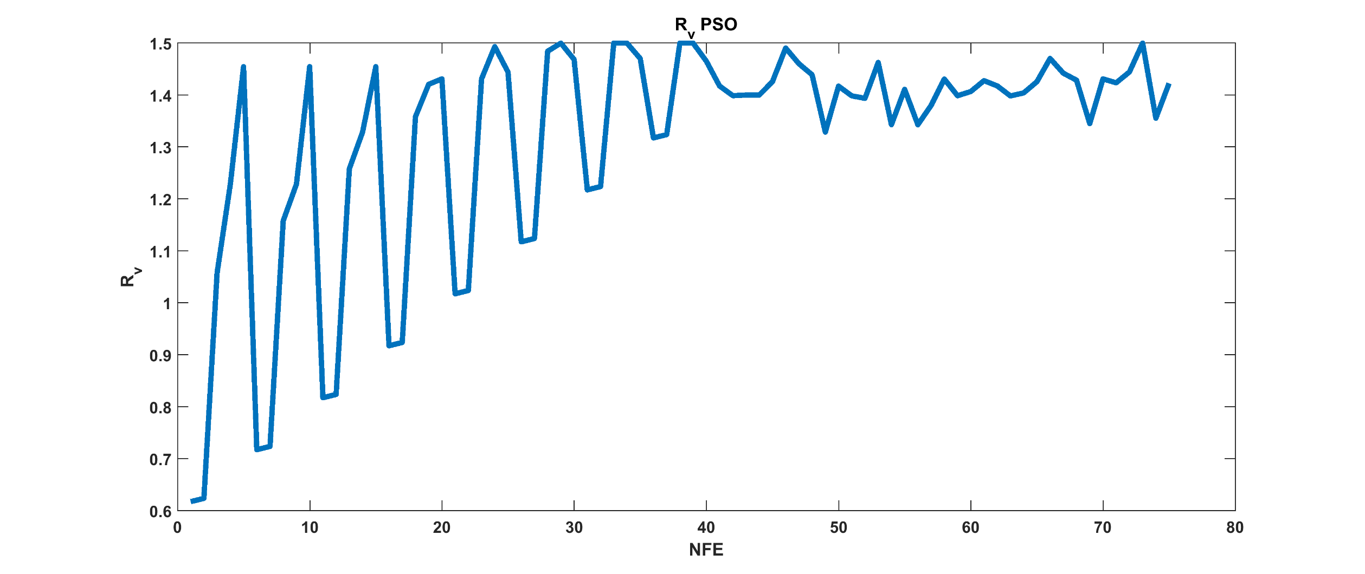
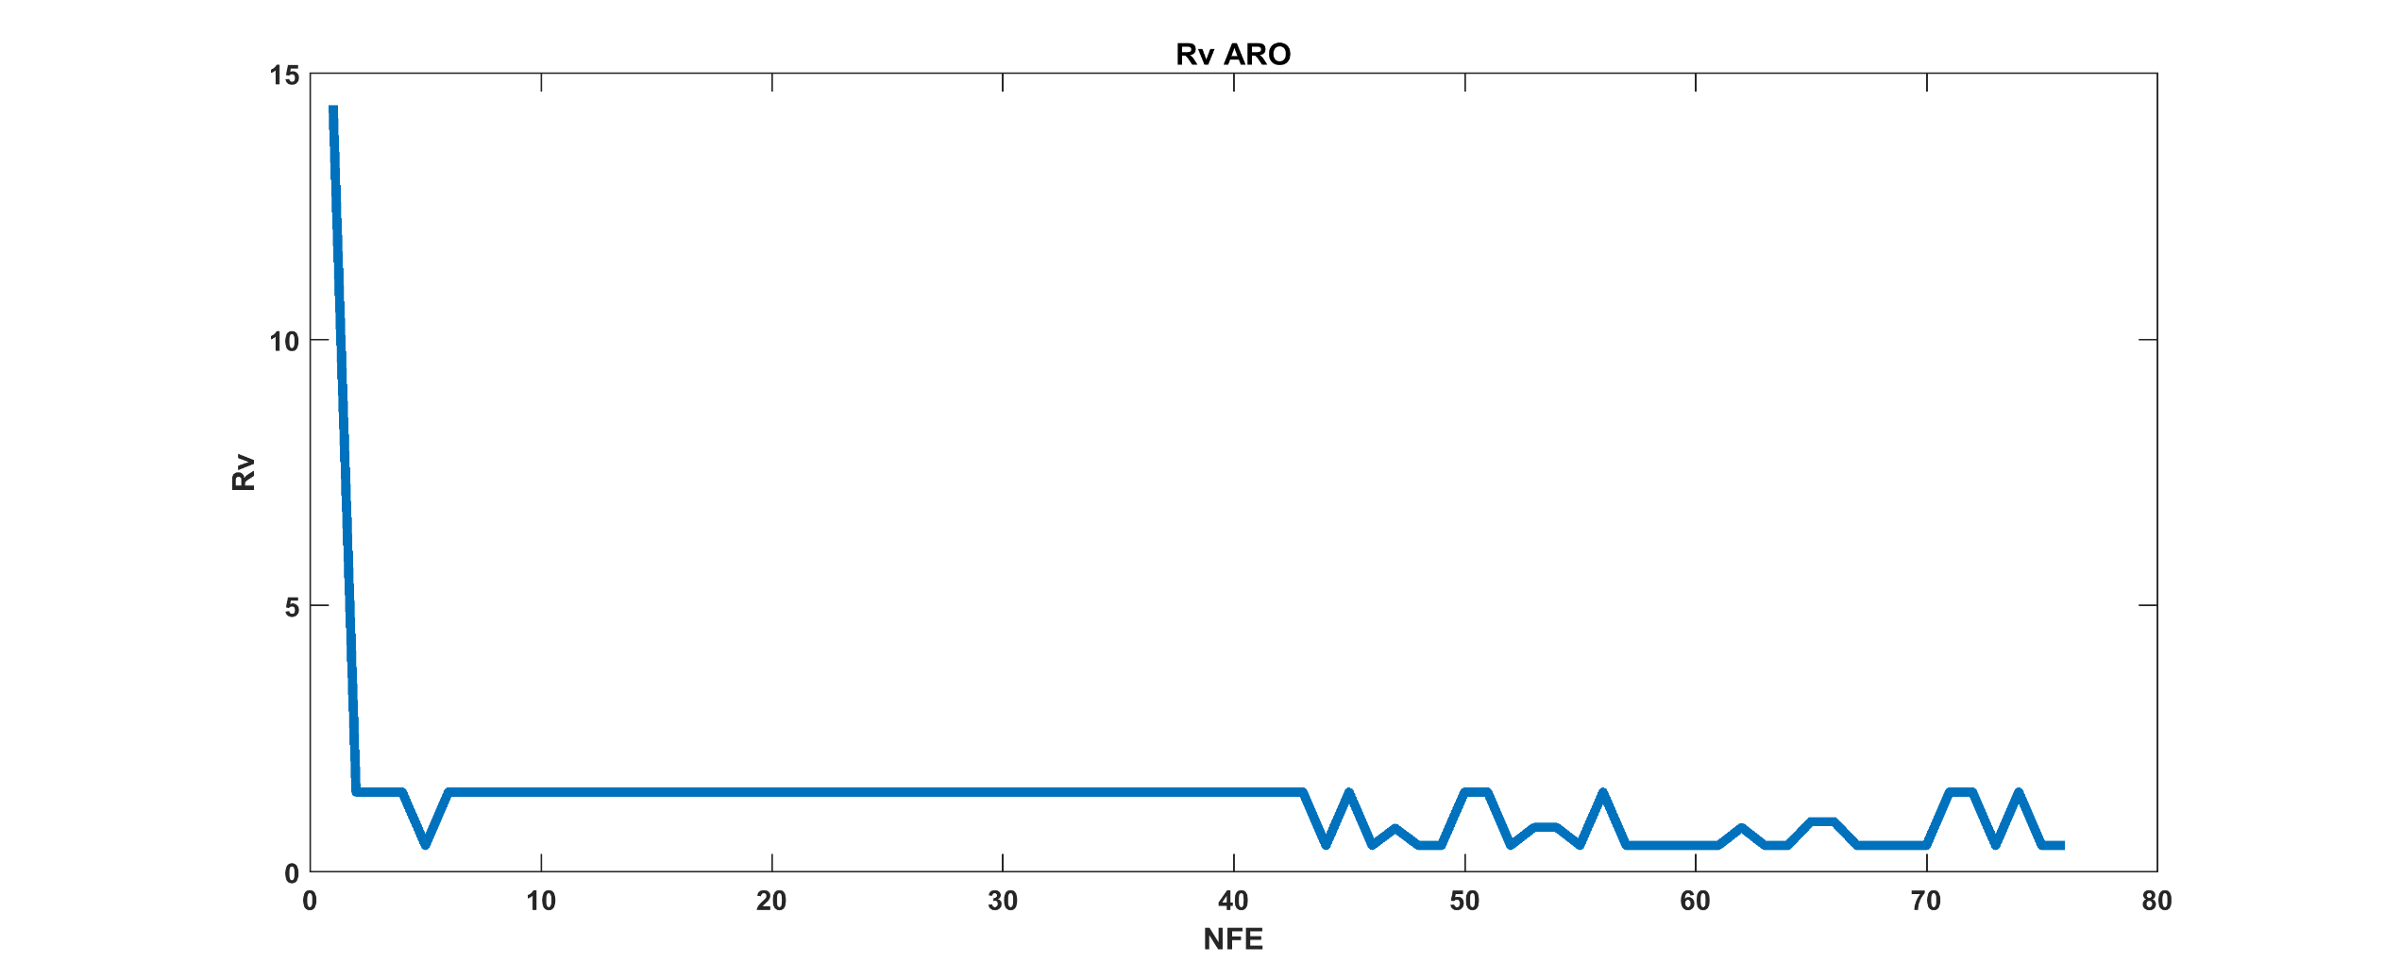

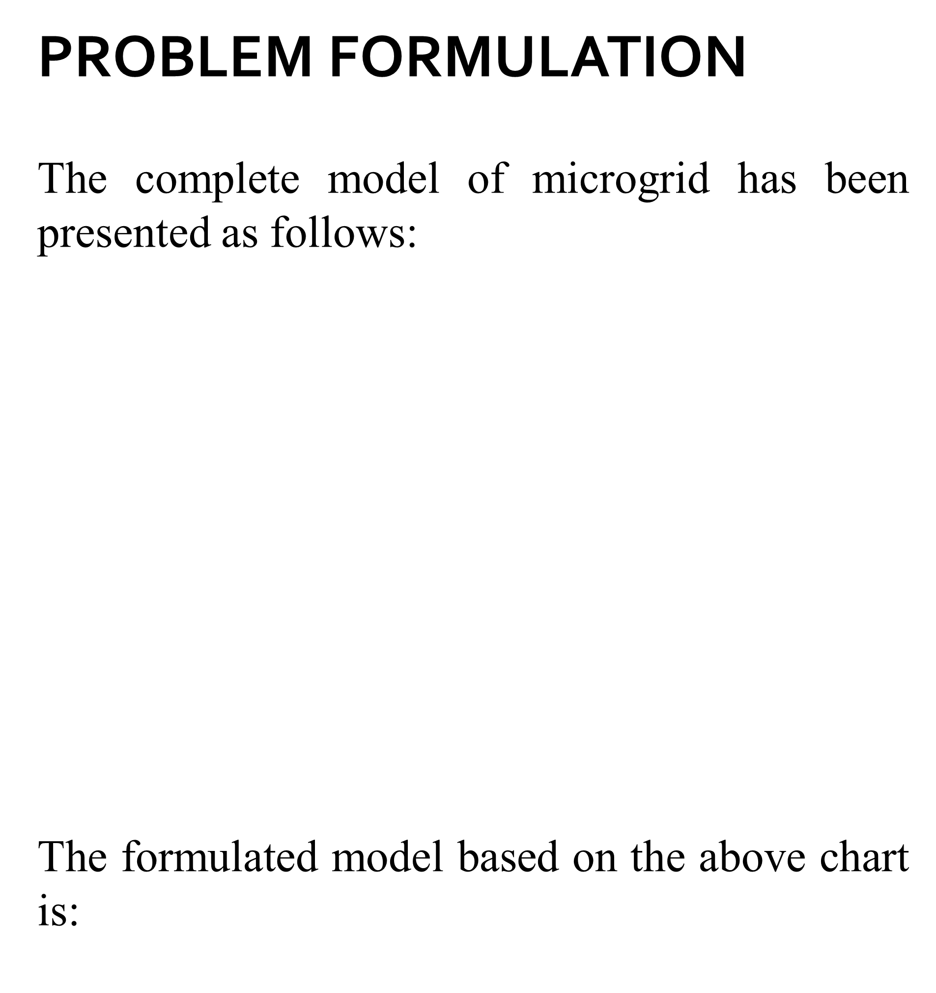
,
Frequency Control of Microgrids by Considering the Energy Storage System Presence for connected and islanding modes
A. Ziroohi, A. A. Suratgar , M. B. Menhaj
Dept. of Electrical Engineering, Amirkabir University of Technology
,
.
.
INTRODUCTION
Using renewable sources and renewable energies are going to be serious in the field of generating electrical power todays, like wind energy and solar energy because of environmental and economical reasons. This subject side with other Small scale generations like fuelcell and microturbines causes developing of a new concept named as distribution generations And side with that microgrid concept. These microgrids can work in two modes, islanding and grid connected. Some challenges exist for exploiters from grid and microgrid. This challenge can be solved when it is connected to main grid but in islanding mode, the distributed energy generators, get the role to control voltage and frequency.
In this thesis, first the microgrid has been introduced then various control methods for frequency and voltage was investigated by considering the energy storage presence. Modeling of a microgrid based on voltage source inverter also has been shown.
Highlights:
Two optimization algorithm named as ARO and PSO used for approaching best parameters for voltage controller, virtual impedance and droop coefficients. The error of voltage and frequency were choosed as the function of optimization. The virtual impedance was mentioned for making the microgrid more stable in droop control loop.
It must be mentioned that the main grid is master in grid connected mode so further studies is not necessary.
The simulation was done using MATLAB/Simulink for verification of this application.
PROBLEM FORMULATION
The complete model of microgrid has been presented as follows:
The formulated model based on the above chart is:
RESULTS
In this thesis, a microgrid based on the voltage source inverter was presented then two optimization algorithm named as ARO and PSO were choosed to optimize the parameters like virtual impedance, droop coefficients and voltage control parameters. As the following charts shows, we can see that PSO algorithm worked bettern in this case how ever needs more loops for finding best answer. On the other hand, the ARO algorthim found the answer faster but with some error that can be acceptable in some cases. We can conclude finally that making ARO as a choice of optimization algorithm can be reliable if error bound is somehow negligible. PSO also can guarantee the last value of cost function at same loop numbers and most of the time better than other optimization algorithms but if the time is a critical problem, then must use this algorithm with more investigations.
SIMULATION RESULTS
A. frequency of microgrid with optimizing the values by ARO and PSO algorithms.
B. state of virual impedance comparing two algorithms

